Slide 1







Welcome to WHPA
The global health professions collaborating for better health for all
Notes:
World Health Professions Alliance is an alliance of the global bodies representing the five major health professions:
Nursing
Medicine
Pharmacy
Dentistry, and
Physiotherapy
(when presenting to midwives say “five of the main health professions”, as in terms of size they would also fit in the list)
WHPA is the only alliance that speaks for the key health professions worldwide.
It was founded in 1999 by three professions (ICN, FIP, WMA) looking to maximize their impact on the global stage by joining together and demonstrating interprofessional collaboration.
25 years and two additional members (FDI, World Physio) later, WHPA now represents 47 million health professionals and has a strong focus on advocacy and communications in areas of shared interest.
It works to improve global health and the quality of patient care and facilitates collaboration among the health professions and major stakeholders.

Slide 2













WHPA in brief
United leadership for the health professions since 1999
47 million
Interprofessional collaboration
health professionals
promotes, practises and leads on ICP
Strengthening health systems
179
countries or territories
advocates for the pivotal role of health professionals
735
Partnership
national member organizations
collaborates with like-minded partners to advance the health professions and UHC
Notes:
The numbers demonstrate WHPA’s global reach.
On the right are our strategic goals, set out in the WHPA Strategy 2024-27
https://www.whpa.org/about/strategic-priorities
WHPA is the only alliance which convenes knowledge and experience from the key health care professions in more than 179 countries and territories
Together, the global organizations in the WHPA have 735 national member organizations, making us the key point of global access to health care professionals within the five disciplines.
We work to facilitate collaboration among the health professions and major stakeholders such as governments and international organizations, including the World Health Organization. By working in collaboration, instead of along parallel tracks, patients and health systems benefit.
WHPA is a voluntary Alliance, overseen by the CEOs of the five member organizations. It is implemented by a secretariat which coordinates the collaboration between the members at three levels – at CEO level, between the policy/advocacy teams, and between the communications teams.
----------------------------------
In case of questions
Resources provided by members
Financial: Each member pays an annual membership fee (currently CHF 15K) which covers costs for activities and day-to-day running of WHPA and finances one 50% position for secretariat management and alliance coordination.
In-kind: Each member provides one hour or less of its CEO’s time per month (short online meetings about every eight weeks and input/oversight at strategic points in between); members’ policy/advocacy and comms teams provide input and support for activities as required where the bulk of the work is done by the secretariat.

Slide 3











What we do
Leadership, outputs and partnerships
Global health leadership
WHO governance
Advocacy
Policy statements
Partnerships
Unique publications
Webinars, events, press releases, communications campaigns eg on health workforce issues
Memorandum of Understanding with WHO since 2022; frequently invited to partner with global health actors
Speak for the professions at leadership meetings of the global health community
Joint WHPA statements to WHO governing bodies; side events at World Health Assembly
Global leadership on shared issues, such as inter-professional collaboration
Report on the impact of Covid on the professions based on members’ data, published by WHO
Notes:
Examples for each category
Global health leadership
https://www.whpa.org/news-resources/news/20250325-whpa-demands-action-clean-air-all
https://www.whpa.org/news-resources/news/20250403-health-workforce-shortages-endanger-patient-safety
WHO governance
https://www.whpa.org/news-resources/interventions
https://www.whpa.org/news-resources/news/20250528-whpa-champions-health-workforce-pivotal-world-health-assembly
Advocacy
Webinar: https://www.whpa.org/news-resources/news/20251015-bridging-global-health-agendas-ncds-amr-and-interprofessional
Press release: https://www.whpa.org/news-resources/statements/press-release-whpa-leaders-attending-4th-un-hlm-ncds
Event: https://www.whpa.org/news-resources/news/20230407-whpa-speaks-post-pandemic-protections-fifth-global-forum-human
Comms campaign: https://www.whpa.org/news-resources/news/20231118-what-can-you-do-reduce-amr
Policy statements
https://www.whpa.org/news-resources/statements/whpa-statement-interprofessional-collaborative-practice
Partnerships
In addition to MoU with WHO:
Ongoing negotiations to partner with World Federation of Public Health Associations and International Federation of Pharmaceutical Manufacturers Associations, initiated by them
Also regularly sought-out by other global health actors to contribute as the voice of the health professions, e.g.:
Invited to speak at WHO Global Clean Air Conference
Invited to WHO Global Oral Health Conference
Invited to advise NCD Alliance on policy report and health workforce recommendations
Publications
https://www.whpa.org/news-resources/what-covid-19-pandemic-has-exposed-findings-five-global-health-workforce-professions

Slide 4
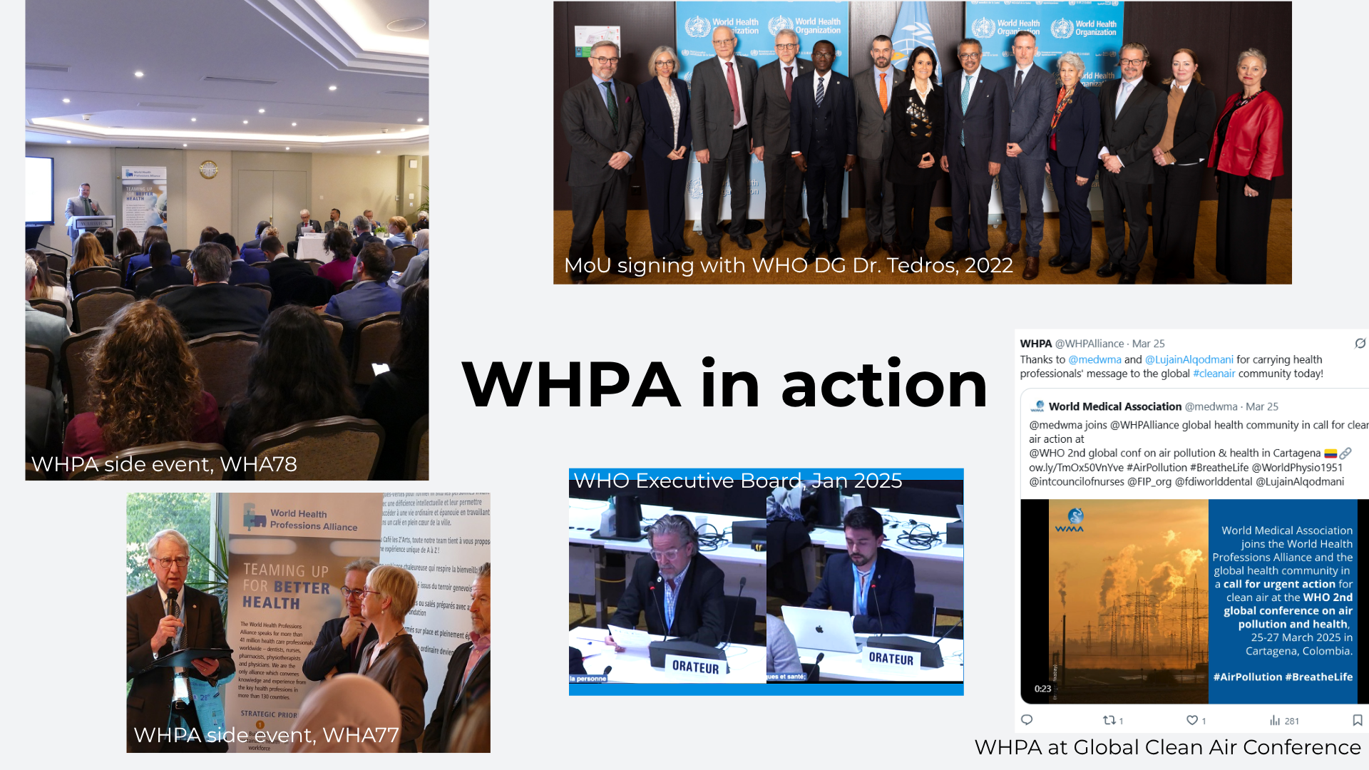
Notes:
WHPA side event, WHA78
https://www.whpa.org/news-resources/news/20250519-wha78-side-event-rising-challenges-diminishing-resources-investing
WHPA members’ Presidents address WHA delegates
WHPA side event, WHA77
https://www.whpa.org/news-resources/news/20240529-wha77-side-event-ncds-and-workforce-dynamics-empowering-tomorrows
Two senior WHO leaders as keynote speakers on health workforce and NCDs
MoU signing, Nov 2022
https://www.whpa.org/news-resources/news/20221108-memorandum-understanding-signed-who
WHO Executive Board, Jan 2025
https://www.whpa.org/eb156-constituency-statement-health-and-care-workforce-agenda-item-12
https://www.whpa.org/eb156-constituency-statement-climate-change-and-health-agenda-item-22
Global clean air conference, March 2025
https://www.whpa.org/news-resources/news/20250325-whpa-demands-action-clean-air-all

Slide 5












Community building
The health professions supporting each other
Regular collaboration
Peer support
Joint outputs
Shared campaigns
Mutual endorsement
Connections facilitated
lateral connections between members fostered at regular meetings of policy and comms teams
developed through collaborative discussions between members’ policy teams
for example at CEO level to identify shared priorities and directions
members’ communications teams amplify WHPA’s and each other’s messaging
of members’ products, when aligned
Presidents and global association members connect with other health professions at WHPA events
Notes:
No additional text, should be self-explanatory. Please get in touch with the WHPA Secretariat if you have any questions: jcwengler@whpa.org

Slide 6









WHPA Impact 09/2024 - 09/2025
1
Global health governance
Interprofessional collaboration
4
  5 constituency statements at WHO governing bodies
  Connection with WHO at leadership level
  Updated WHPA statement
  Interprofessional AMR webinar
2
Shape WHO policy
Shape NGO outputs
5
  Expert review group for ethical recruitment
  Input for infection prevention and control curricula
  Advised NCD Alliance on policy report and health workforce recommendations
3
Agenda setting
Sought-out partner
6
  2 UHC Day statements
  WHA78 side event
  Global Ministerial Summit on Patient Safety
  Summit for the Future
  Invited to speak at WHO Global Clean Air Conference
  Invited to WHO Global Oral Health Conference
  Partnership sought by IFPMA
  4 invitations to contribute to WHA78 side events
Notes:
Statements :
EB156: Health and care workforce (Agenda Item 12); Climate change and health (Agenda Item 22)
WHA78: Universal health coverage (Agenda Item 13.3); Health emergencies (Agenda Item 16.1); Climate change and health (Agenda Item 22)
Ensured that health professionals’ perspective was added to several relevant agenda items
Regular meetings every 2 months between WHO Director of Health Workforce and WHPA leadership
WHPA is a member of the Expert Advisory Group on the WHO Global Code of Practice on the International Recruitment of Health Personnel
WHPA coordinated input from member organizations to curricula developed by the Education and Training Working Group of the Global Infection Prevention Control Network (GIPCN), secretariat at WHO. Contact with this group stemmed from an earlier invitation to contribute to the development of WHO’s Global Infection Prevention and Control Strategy.
UHC Day statements produced to coincide with development of EB156 resolution on health workforce and were shared directly with key delegates negotiating the resolution; topics: invest in health professionals for UHC and because community health workers need supervision by HPs; and interprofessional collaboration is essential for delivering primary health care.
WHA side event (May 2025) was sold out and there was strong engagement from participants; served to ensure that health professionals’ perspectives were voiced in a dedicated forum; the event was advertised on several directories of side events, securing a health professional presence.
Global Ministerial Summit on Patient Safety (April 2025): 3 WHPA members had a presence there; 2 WHPA members were on the steering committee, ensuring that health professionals’ perspectives were taken into account in the content of the event
Summit for the Future (Sept 2024): 2 WHPA leaders present at the Summit; Press Release highlighted need to invest in health workforce; WHPA also contributed to 2 consultations in the run-up to the Summit, pointing out the absence of health and the health workforce in the outcome document
Over 1,500 page views of updated WHPA statement on Interprofessional Collaborative Practice in July 2025
Over 500 participants in the webinar (Nov 2024): participant feedback was that it was quite unique and useful to have a truly interprofessional take on AMR; excellent example also of collaboration between the WHPA members.
WHPA was invited to join Expert Advisory Group for this publication; WHPA coordinated input from members which can be traced in the published recommendations
Clean Air Conference (March 2025): 1 WHPA leader spoke on 2 occasions
Oral Health (November 2024): 1 WHPA leader present
IFPMA: International Federation of Pharmaceutical Manufacturers’ Associations; initial meetings held to ensure compatibility and on what terms; now exploring possible areas and activities for collaboration

Slide 7










Benefits for Alliance members
Stronger advocacy
Extended influence
One joint voice weighs heavier than five separate ones; WHPA covers core health workforce topics of importance to all members
More involvement in WHO governance, policy making and programs means more international influence
Increased visibility
Demonstrable collaboration
Contact with additional partners and stakeholders; systematic use of members' logos
Shows that members are "walking the talk" on interprofessional collaboration
Additional activities
Efficient resource use
WHA/EB statements, presence at international meetings, policy statements, webinars, communications that members would not otherwise have
Activities carried out largely by WHPA Secretariat with support and oversight by members
Notes:
Members have shared topics of interest but may rank them differently in their priorities. When WHPA acts on a topic which is of interest to a member but not its top priority, that member gains traction on that topic without having to divert significant resources to it or diluting its core messaging.
Each member benefits from the network of the others: if WHPA is invited to participate in an activity because one member has particularly good connections there, then all members benefit from that connection
Equally, when WHPA makes itself visible in a context where one member is more present, all members gain visibility in that context
WHPA’s value as a single point of access for the professions is becoming more well-known; invitations (to collaborate, for input and expertise etc) often highlight that value.

